Slide 1

Detection of Credit card fraud
Poli Ghosh

Slide 2
Contents
Introduction
Problem Definition
Proposed Solution
Block Diagram
Implementation
Results and Conclusion

Slide 3
Introduction
More than 80% of Americans have at least one credit card.
The average American has 3.84 credit card (Experian,2022).
After the pandemic, cash usage has decreased significantly.
Online shopping – one of largest and fast-growing trend.
Mode of payment – credit card, debit card and net banking.
Online payment does not require physical card.
Major Risk – credit/debit card detail is known to others.

Slide 4
Problem Definition
Online Payment does not require physical card.
Anyone who knows the details of the card can make fraud transactions.
Currently, card holders only comes to know only after the fraud transaction is carried out.
No mechanism to track the fraud transaction.

Slide 5
Proposed Solution
Since we can only stop transactions if we find anything unusual, we try to find better techniques to find unusual activities.
Different machine learning algorithms are used for finding these unusual transactions.
Following techniques are incorporated in our project
1) Logistic Regression
2) K-Nearest Neighbors
3) Naïve Bayes
4) Decision Tree
5) Random Forest

Slide 6
Dataset used
The dataset contains transactions made by credit cards in September 2013 by European cardholders. This dataset presents transactions that occurred in two days, where we have 492 frauds out of 284,807 transactions. The dataset is highly unbalanced, the positive class (frauds) account for 0.172% of all transactions.
It contains only numerical input variables which are the result of a PCA transformation. Unfortunately, due to confidentiality issues, we cannot provide the original features and more background information about the data. Features V1, V2, ... V28 are the principal components obtained with PCA, the only features which have not been transformed with PCA are 'Time' and 'Amount'. Feature 'Time' contains the seconds elapsed between each transaction and the first transaction in the dataset. The feature 'Amount' is the transaction Amount, this feature can be used for example-dependent cost-sensitive learning. Feature 'Class' is the response variable and it takes value 1 in case of fraud and 0 otherwise. There are no “NA” values in the dataset.

Slide 7
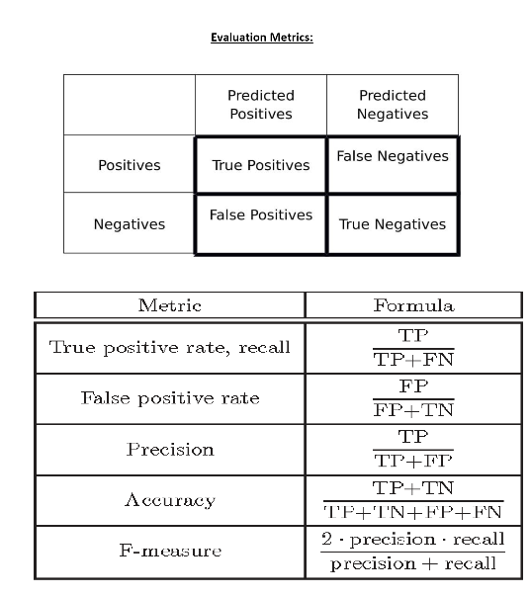
Evaluation Metrics

Slide 8
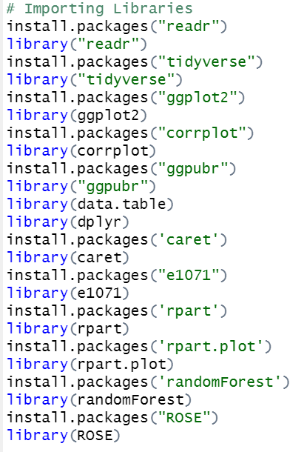
Packages Used

Slide 9
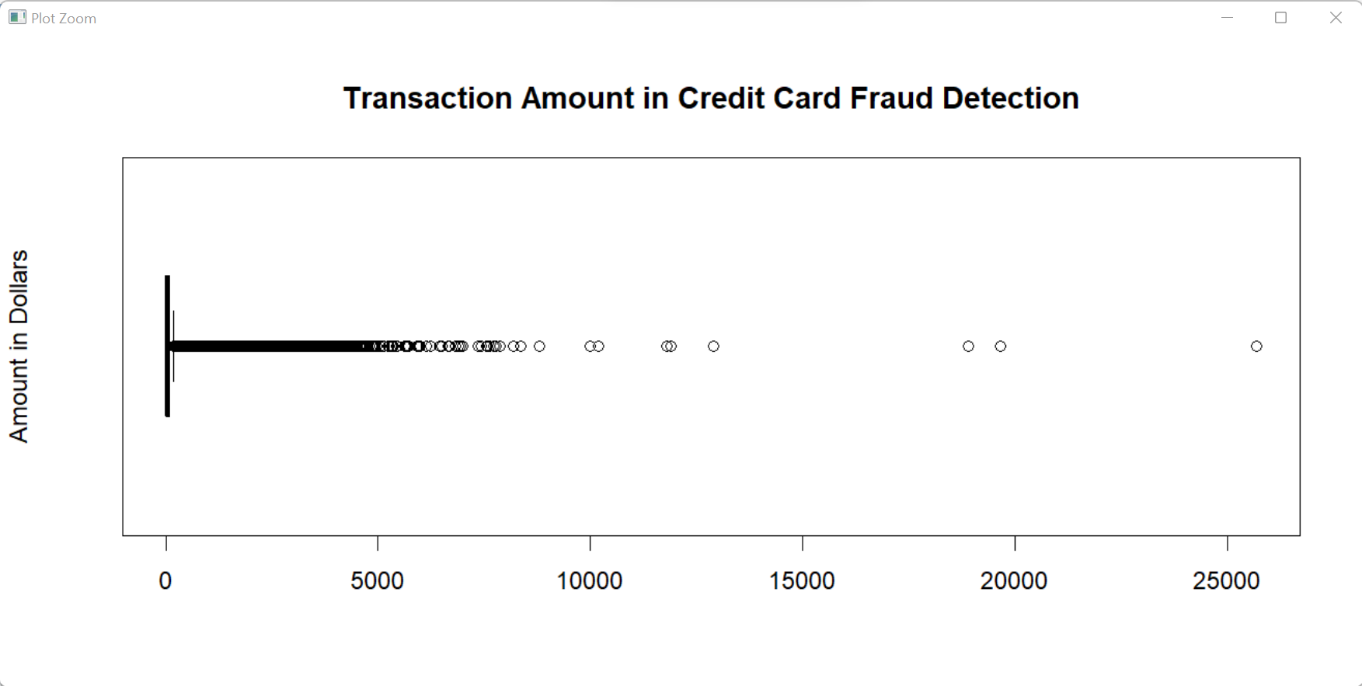
Exploratory Data analysis - Plotting Boxplot for amount feature (Observed lot of outliers)

Slide 10
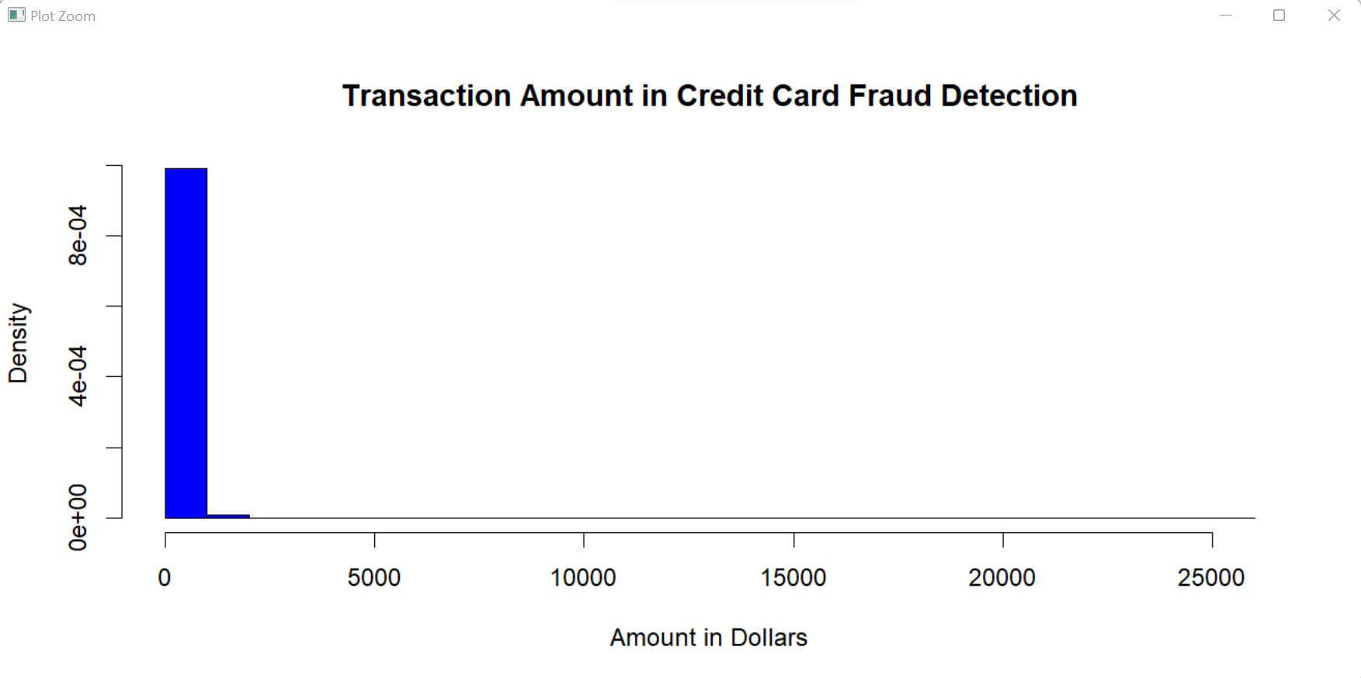
Plotting histogram for amount feature (Right Skewed histogram)

Slide 11
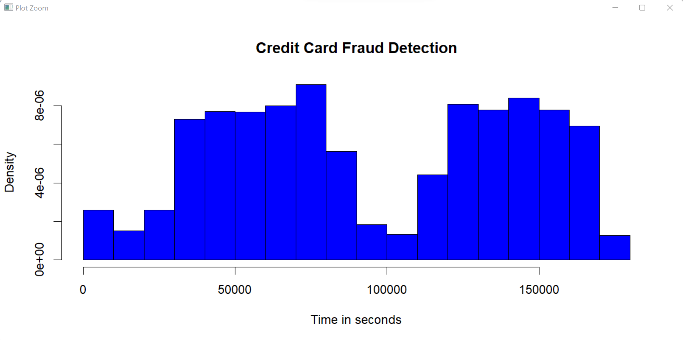
Plotting histogram for time feature

Slide 12
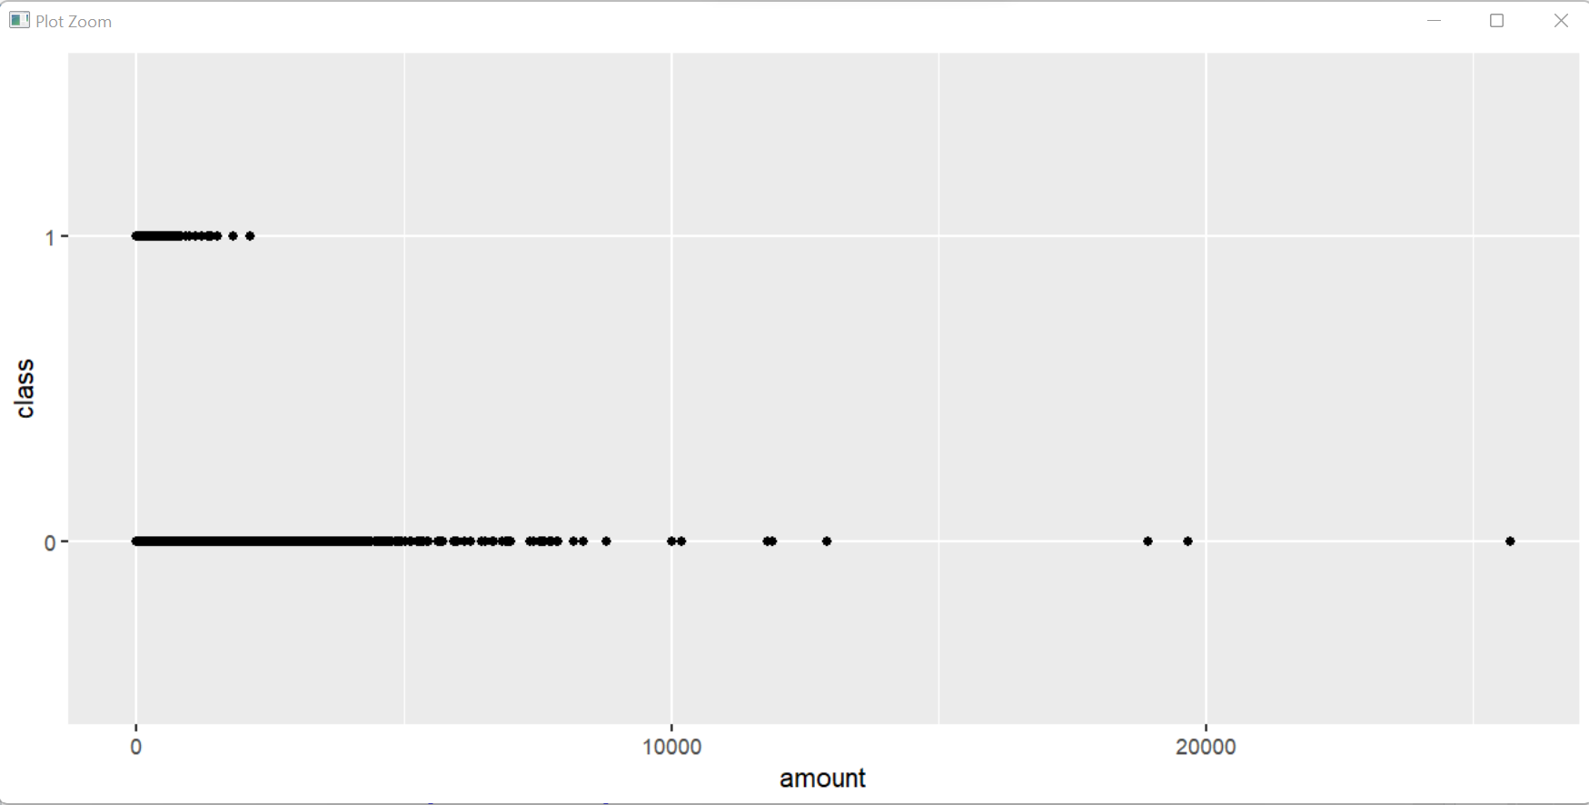
plotting a scatter plot between amount and class feature

Slide 13
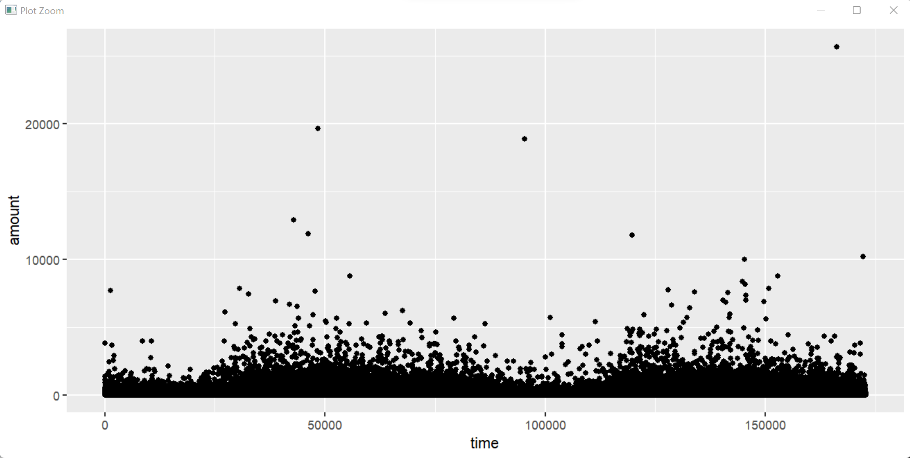
plotting a scatter plot between amount and time feature

Slide 14
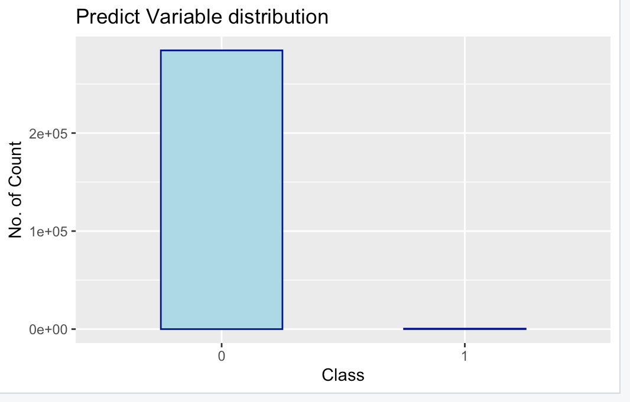
Before performing Under-sampling and over-sampling

Slide 15
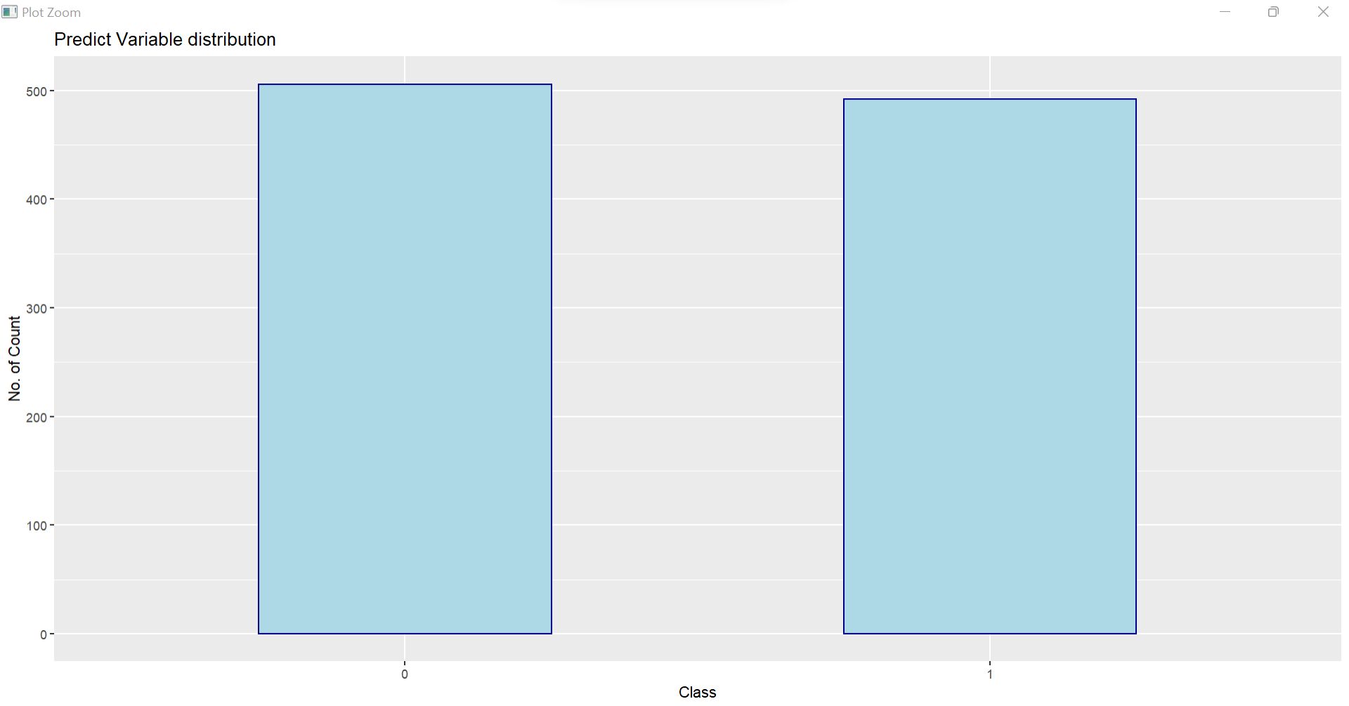
after performing Over-sampling

Slide 16
Logistic Regression
We divided the data into train and test groups and cleaned it up by determining if the characteristics were categorical or factored.
Made sure that all the independent variables are categorical, and our dependent variable is binary, meaning it can only be one of two values: 0 or 1.
The logistic regression model was run using the “logit. reg” command and the following is the outcome
Accuracy | 0.947
Sensitivity | 0.9154
Specificity | 0.9781
FPR | 0.01942231
FNR | 0.08232932
Precision | 0.9791109
F1_Score | 0.9473957

Slide 17
K-Nearest Neighbors
The K-NN Classification model, one of the simplest supervised learning classification models, is the next model we run.
It’s easy to implement and understand but has a major drawback of becoming significantly slows as the size of that data in use grows.​
We used a 10-fold cross-validation method to get the best model with the best accuracy. The following are the outcome:
Accuracy | 0.99975
Sensitivity | 1
Specificity | 0.9997497
FPR | 0.0002502503
FNR | 0
Precision | 0.8
F1_Score | 0.8888889

Slide 18
Naïve Bayes
It was used for fast and easy implementation.
Here the biggest disadvantage is that the requirement of predictors to be independent.
In most of the actual scenarios, the predictors are dependent, this hinders the performance of the classifier.
This approach is commonly used in text categorization and when dealing with problems that have several classes.
To determine the model's performance, we utilized a Naive Bayes classifier and performed a confusion matrix.
Accuracy | 0.977
Sensitivity | 1
Specificity | 0.976977
FPR | 0.02302302
FNR | 0
Precision | 0.04166667
F1_Score | 0.08

Slide 19
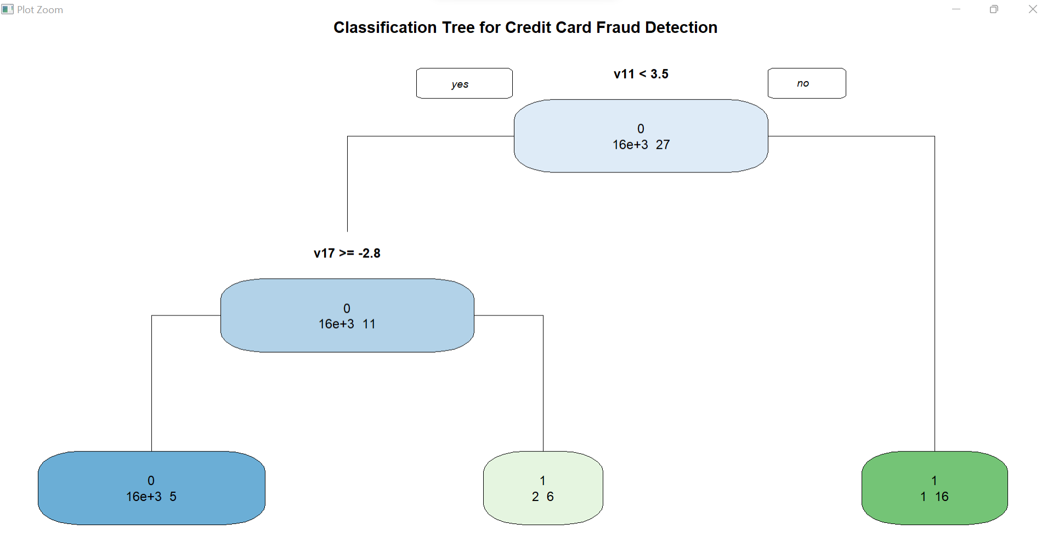
Decision Tree
Accuracy | 0.9995
Sensitivity | 0.8148148
Specificity | 0.9998122
FPR | 0.0001878169
FNR | 0.1851852
Precision | 0.88
F1_Score | 0.8461538
For classification and regression, Decision Trees (DTs) are a non-parametric supervised learning method.
To partition the tree according to the chosen variable, we utilize INFORMATION GAIN, and to measure impurity, we use GINI INDEX and Entropy.
Furthermore, we can undertake parameter adjustment and cross-validation to avoid overfitting.
This is the result obtained after running the algorithm.

Slide 20
Modelling using UNDER-sampling

Slide 21
Logistic Regression
We divided the data into train and test groups and cleaned it up by determining if the characteristics were categorical or factored.
Made sure that all the independent variables are categorical, and our dependent variable is binary, meaning it can only be one of two values: 0 or 1.
The logistic regression model was run using the “logit. reg” command and the following is the outcome
Accuracy | 0.9387755
Sensitivity | 0.8977273
Specificity | 0.9722222
FPR | 0.02777778
FNR | 0.1022727
Precision | 0.9634146
F1_Score | 0.9294118

Slide 22
K-Nearest Neighbors
The K-NN Classification model, one of the simplest supervised learning classification models, is the next model we run.
It’s easy to implement and understand but has a major drawback of becoming significantly slows as the size of that data in use grows.​
We used a 10-fold cross-validation method to get the best model with the best accuracy. The following are the outcomes:
Accuracy | 0.9081633
Sensitivity | 0.8409091
Specificity | 0.962963
FPR | 0.03703704
FNR | 0.1590909
Precision | 0.9487179
F1_Score | 0.8915663

Slide 23
Naïve Bayes
It was used for fast and easy implementation.
Here the biggest disadvantage is that the requirement of predictors to be independent.
In most of the actual scenarios, the predictors are dependent, this hinders the performance of the classifier.
This approach is commonly used in text categorization and when dealing with problems that have several classes.
To determine the model's performance, we utilized a Naive Bayes classifier and performed a confusion matrix.
Accuracy | 0.9030612
Sensitivity | 0.8636364
Specificity | 0.9351852
FPR | 0.06481481
FNR | 0.1363636
Precision | 0.9156627
F1_Score | 0.8888889

Slide 24
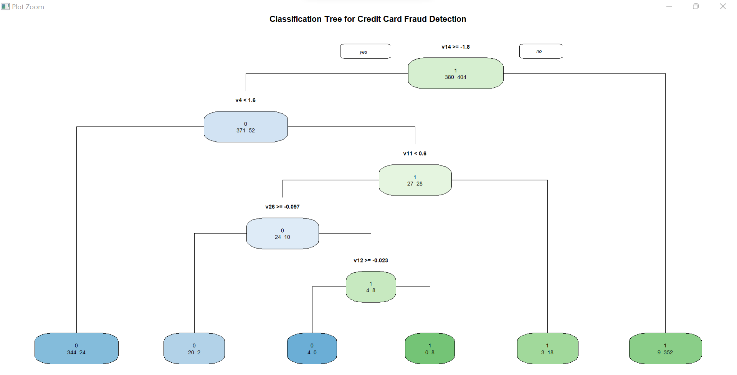
Decision Tree
Accuracy | 0.9515306
Sensitivity | 0.9356436
Specificity | 0.9684211
FPR | 0.03157895
FNR | 0.06435644
Precision | 0.9692308
F1_Score | 0.9521411
For classification and regression, Decision Trees (DTs) are a non-parametric supervised learning method.
To partition the tree according to the chosen variable, we utilize INFORMATION GAIN, and to measure impurity, we use GINI INDEX and Entropy.
Furthermore, we can undertake parameter adjustment and cross-validation to avoid overfitting.
This is the result obtained after running the algorithm.

Slide 25
MODEL SELECTED FOR
OVER-SAMPLING
Logistic regression
F1 Score - 0.95
UNDER-SAMPLING
DECISION TREE
F1 Score - 0.952

Slide 26
Conclusion
Here we have shown most common method of frauds with their detection methods and recent findings.
Demonstrated how Machine Learning along with the algorithms, and pseudocode can be applied to get better results.
Here we have achieved over 95% of accuracy in case of over-sampling and under-sampling.
Here the entire data set consist of only two day’s transaction records. But being based on machine learning algorithms, the program will increase its efficiency as more data is put into it.

Slide 27

Future work
Though the dataset has been well analysed, more analysis can be performed using much advanced machine learning algorithms and considering much larger dataset

